Slide 1

KS1 SATs INFORMATION EVENING
Tuesday 31st January 2023
6pm

Slide 2
KS1 SATs Tests
The SATs tests are held in May.
Writing is Teacher Assessed and will be across a range of writing styles.
Maths: Written Test.
Reading: Written test.
SPAG: Written test.

Slide 3
Key stage 1 – Reading test framework
The key stage 1 English reading test comprises:
Paper 1, a combined booklet that integrates the reading texts and answer booklet which carries 20 marks.
Paper 2, a reading booklet with a separate associated answer booklet which carries 20 marks.
Every pupil should have the opportunity to attempt both papers. Teachers may stop a pupil at any stage of the test that they feel is appropriate.

Slide 9
SPAG Test
Variety of multiple choice and short answers.
Focus will be knowledge of grammatical terms, use of punctuation and spelling.

Slide 10
Key stage 1 English grammar, punctuation and spelling test framework
Format of the test
Paper 1: Spelling
Spelling (20 words) 20 marks 15 minutes
Paper 2: Grammar, punctuation and vocab
20 questions 20 marks 20 minutes
Total 2 papers 40 marks
Recommended time - 35 minutes

Slide 11
Grammar and Punctuation Terms
Noun, adjective, verb, adverb, conjunction.
Present and past tense
Tense agreement
Singular and plural
Root words/ suffixes and prefixes
Contractions
Features of Standard English

Slide 12
Punctuation continued…
How to use commas, full stops, capital letters, question and exclamation marks.
Functions of Sentences – statement, question, command, exclamation.

Slide 13
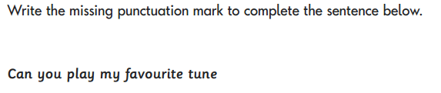
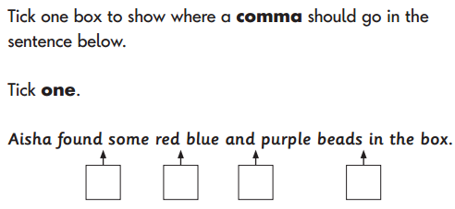
SPAG question examples…

Slide 14
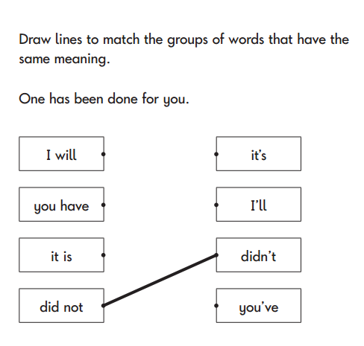
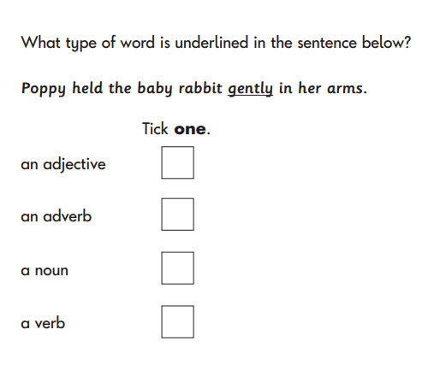

Slide 15
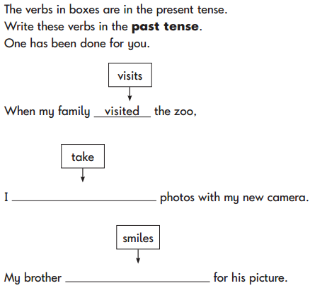
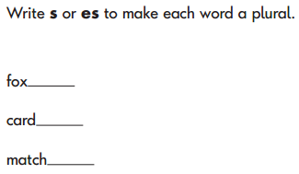

Slide 16
Ways To Help Your Child
Read with your child everyday
Encourage your child to express and develop their opinion, giving reasons.
Encourage your child to think from the author’s point of view.
Point out punctuation / grammar rules in the books that you are reading.

Slide 17


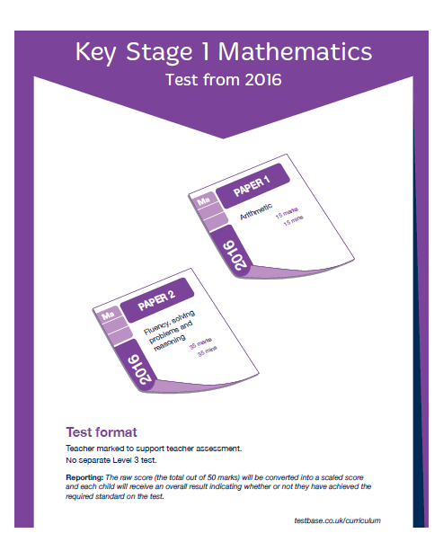
Maths

Slide 18
KS1 Maths SATs Tests
The Key Stage 1 Maths test comprises of two papers, which will be marked internally.

Slide 19
Paper 1
Arithmetic, worth 25 marks and taking around 15 minutes.

Slide 20
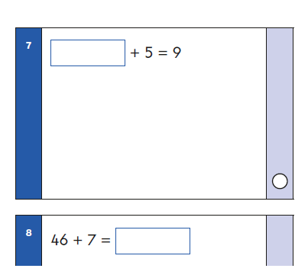
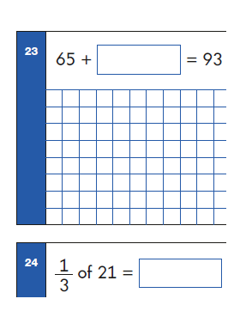
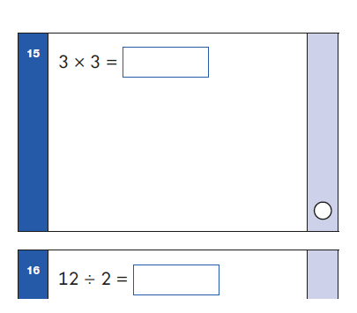
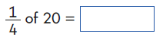
Examples of Questions
1
6
2
7
3
4
5

Slide 21
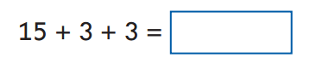
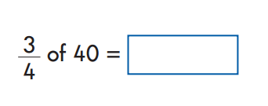
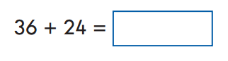
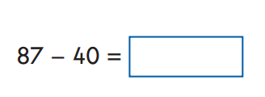
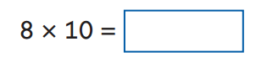

Slide 22
Paper 2
Mathematical fluency, problem-solving and reasoning, worth 35 marks and taking 35 minutes, with a break if necessary.
There will be a variety of question types:
Multiple choice
Matching; true/false
Constrained (e.g. completing a chart or table; drawing a shape)
Less constrained (e.g. where children have to show or explain their method).

Slide 23
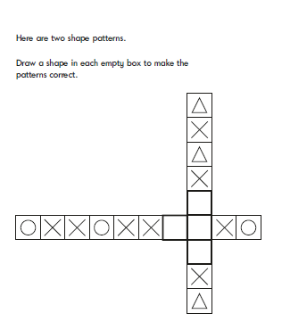
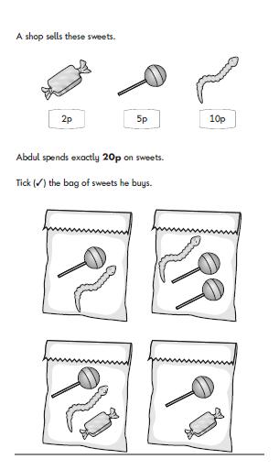
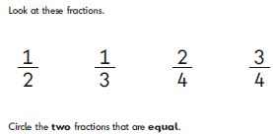
Examples of Questions
1
3
2

Slide 24
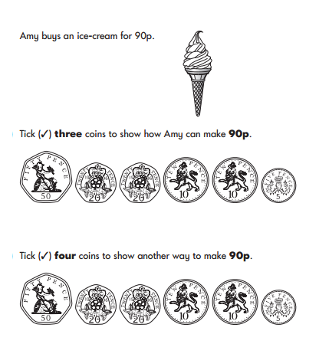
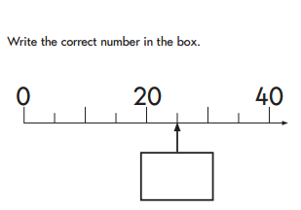
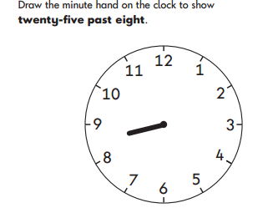

Slide 25
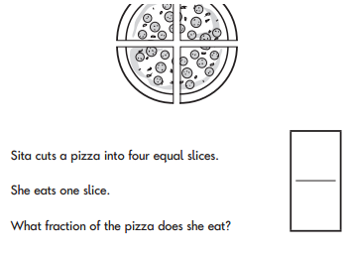
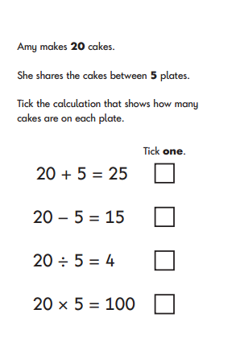
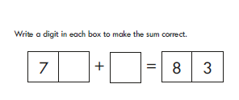

Slide 26
Ways to help your child at home
Make sure your child knows their times tables and can answer out of order.
They must be secure with their number bonds to 10, 20 and 100.
Count on and back in ones, tens, hundreds etc from any number (3, 13, 23, 33..... 567, 467, 367.)
Use a variety of mathematical language – all the different ways a sum can be worded.
Relate addition to subtraction and multiplication to division.
Make their learning relevant – get them to work out practical problems.
Eg: we have 3 people for dinner and 12 slices of pizza – how many will each person get?
Reasoning skills: ask them to explain how they solved a problem.

