Slide 2
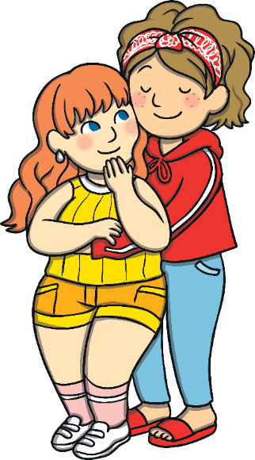
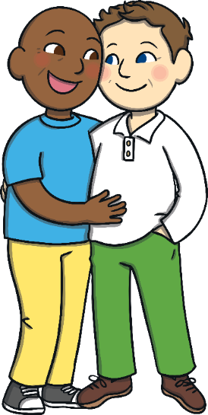
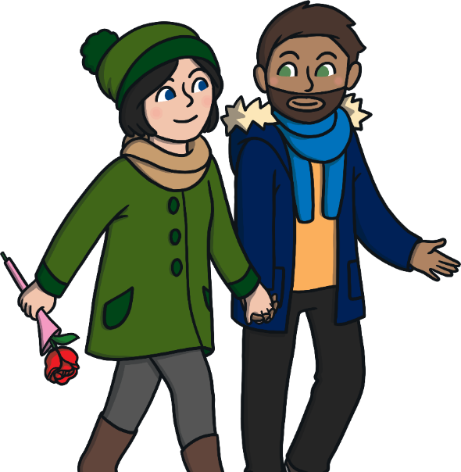
What Is Pride?
Pride is a celebration of people being proud of who they are.

Slide 3
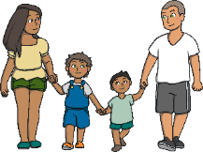
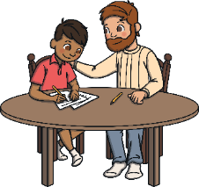
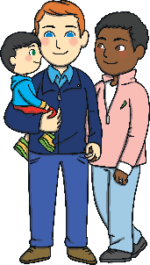
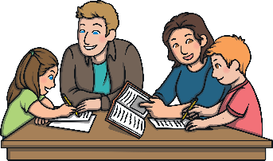
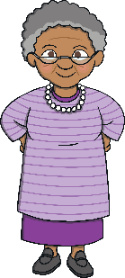
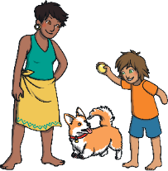
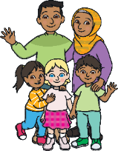
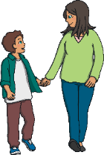

Different Families
stepmother, dad, and children
stepfather, mom, and children
mom, dad and children
dad and son
two dads and
their son
grandmother and grandson
aunt and
nephew
caregivers and children
two moms and their daughter
mom and son

Slide 4
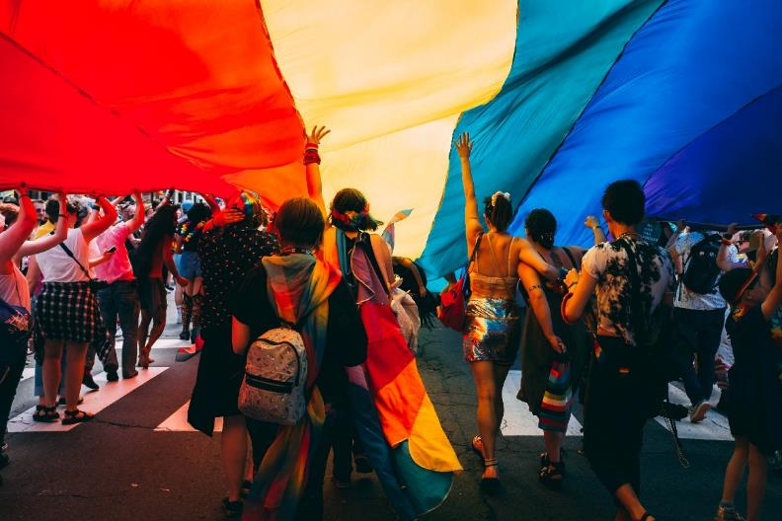
Pride Celebrations
Pride marches, parades, and festivals celebrate the differences between people in our world and promote equal rights for all.
They are held all over the world.

Slide 5
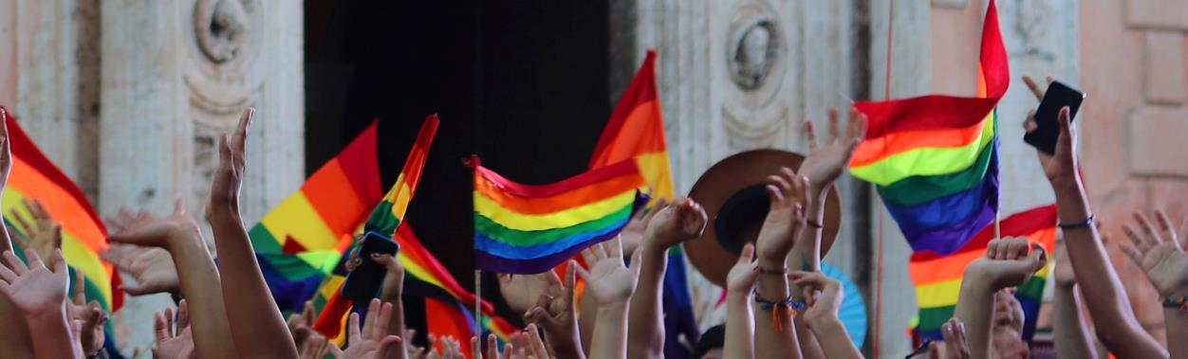
Rainbow Flag
Many people will wave rainbow flags at Pride marches to show that they are proud of who they are and that everyone should be treated equally.

Slide 6

All Different, All Wonderful
Things to remember:
Everyone should feel like they can be themselves.
Everyone should be allowed to be proud of who
they are.

Slide 7
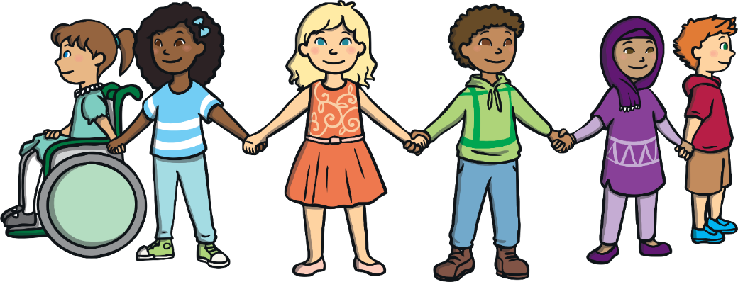
Have Pride!
Everyone is special and unique. We should be proud of the things that make us different.
Why are you proud to be you?

